Slide 1
Android Development: Introduction
Dr. Khin Thanda Soe

Slide 2
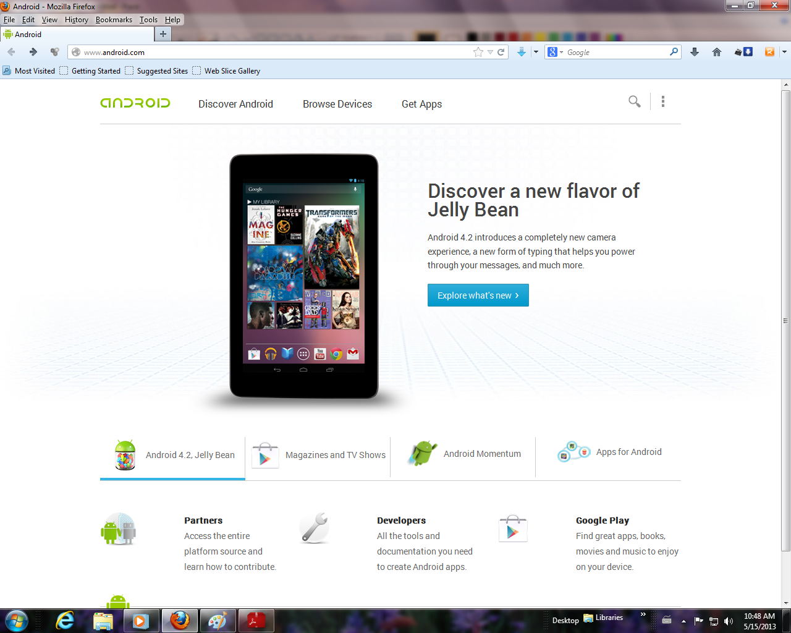
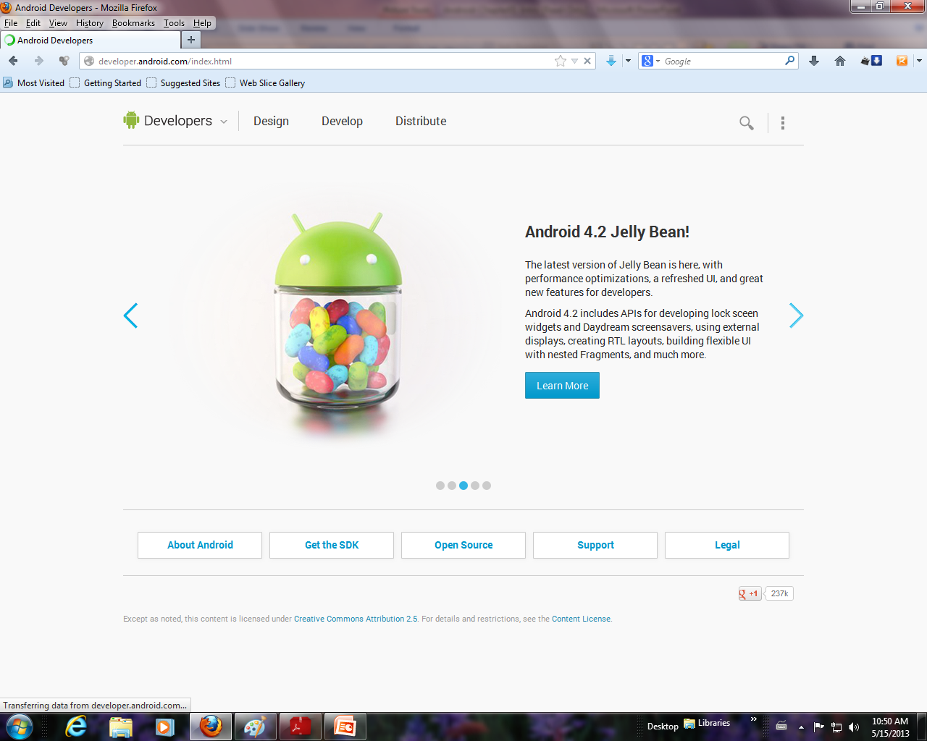
Resources
Android Web pages
http://www.android.com/
http://developer.android.com/

Slide 3
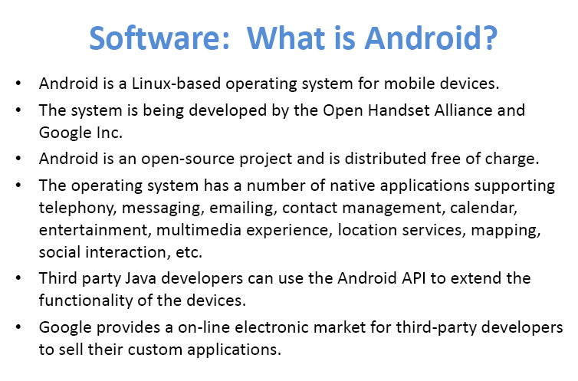

Slide 4


Slide 5
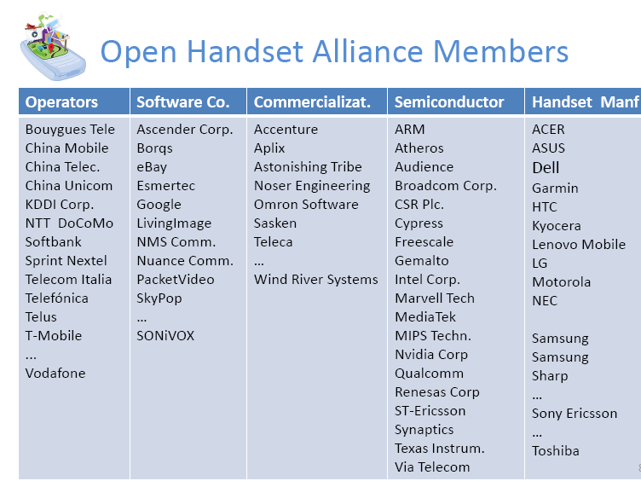

Slide 6
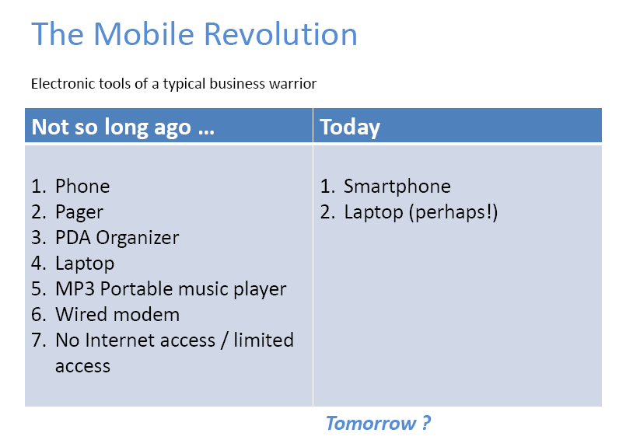

Slide 7
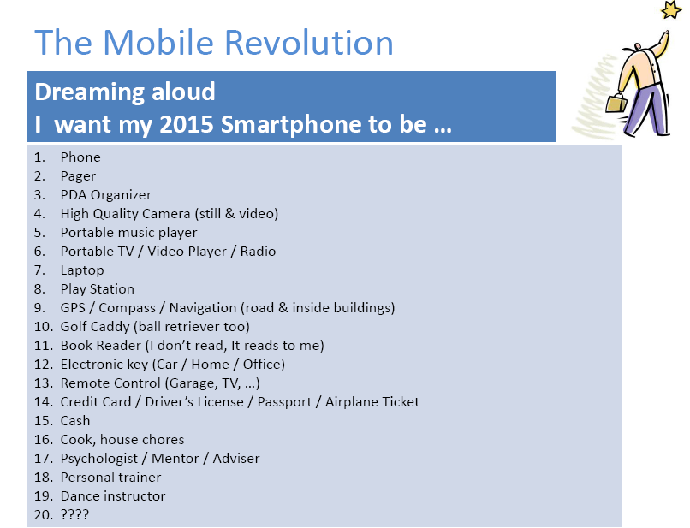

Slide 8
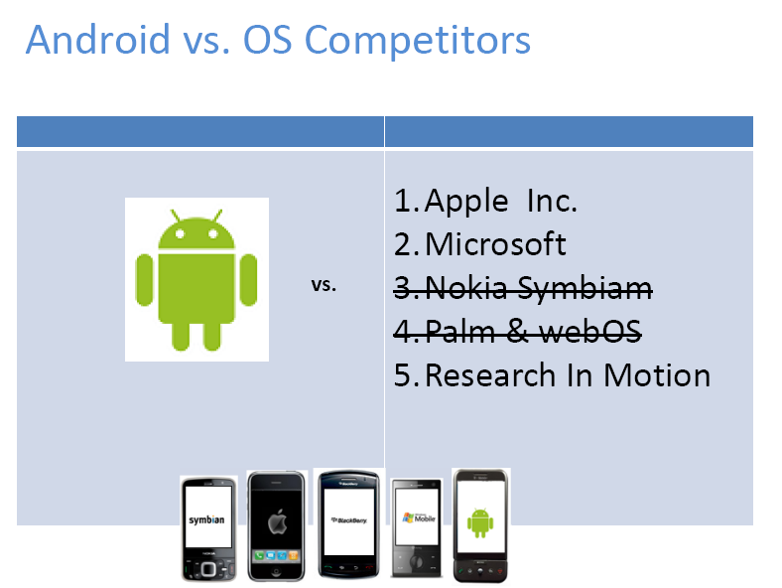

Slide 9
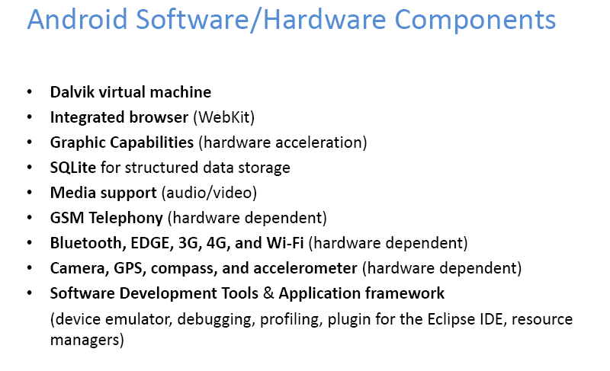

Slide 10
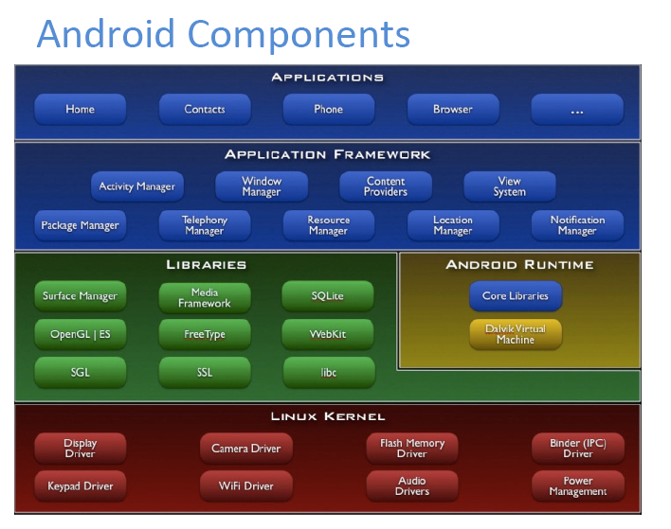

Slide 11
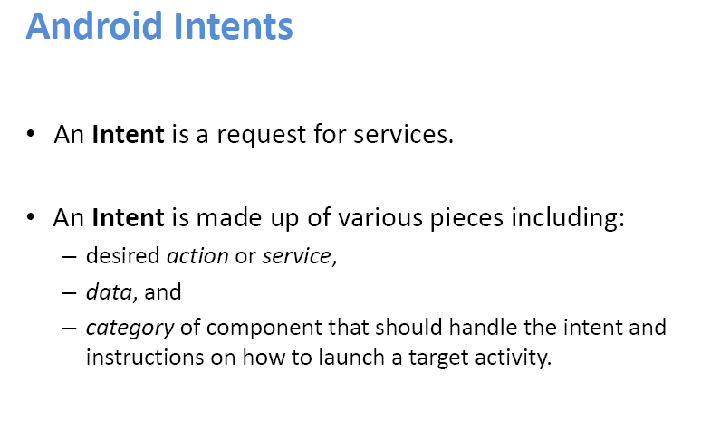

Slide 12
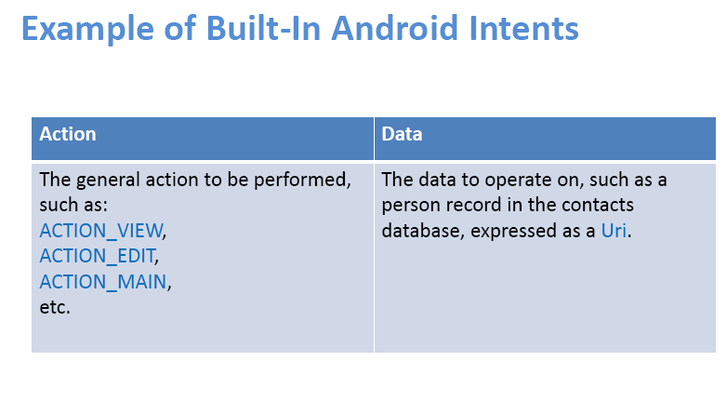

Slide 13
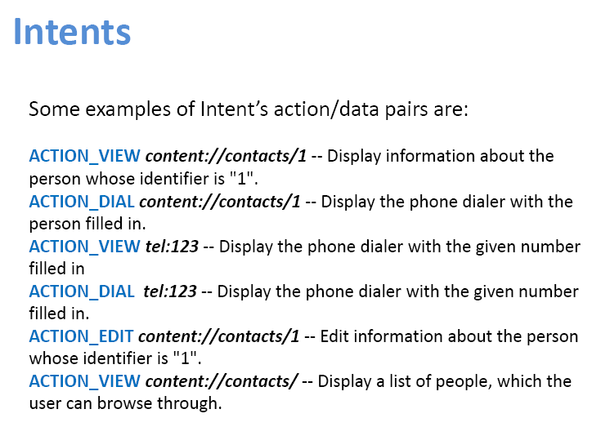

Slide 14
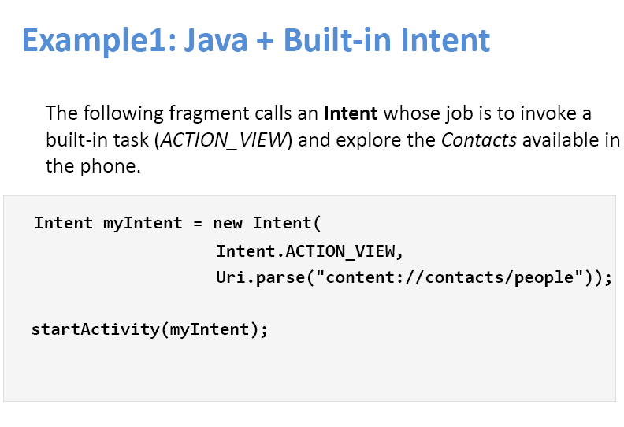

Slide 15
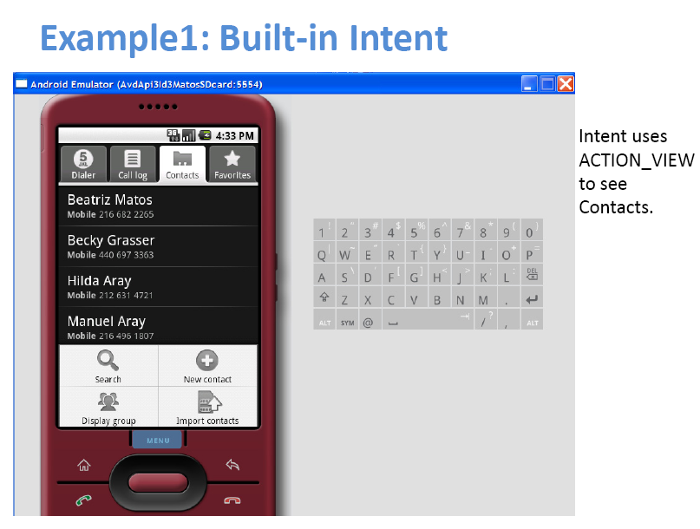

Slide 16
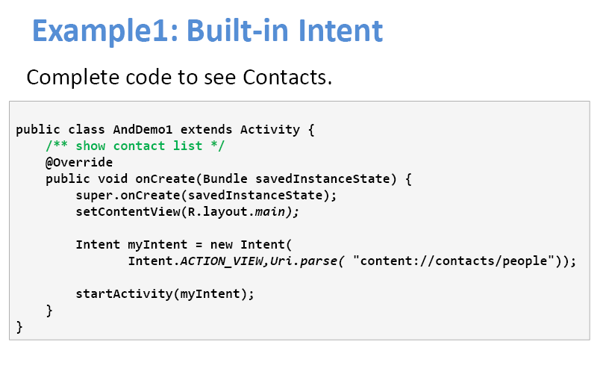

Slide 17
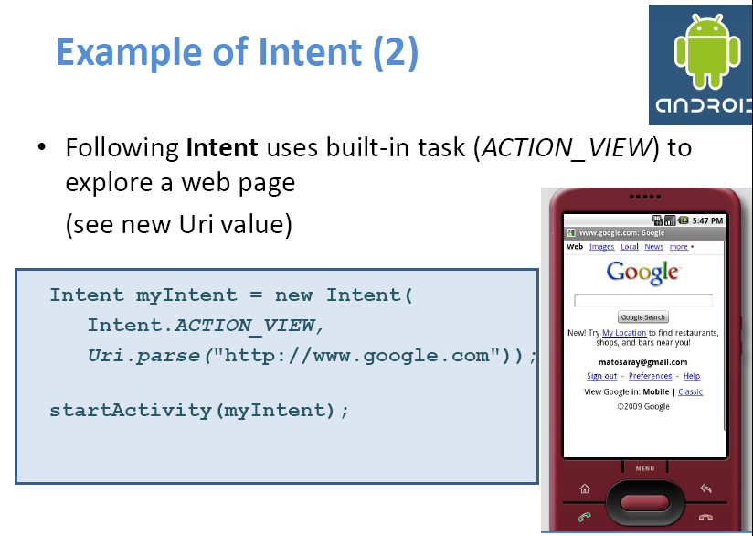

Slide 18
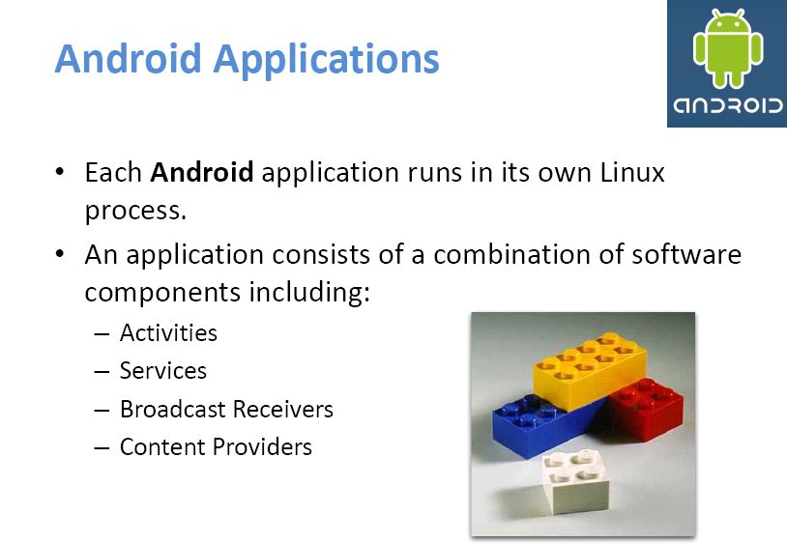

Slide 19
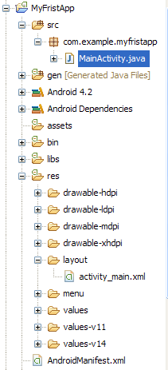
Android Applications
Activities, Services, Broadcast Receiver,
Content Providers
Go Here
Structure of a typical android Application
Resources
Manifest

Slide 20
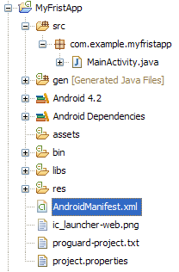
Android Manifest xml file
Every application must have an AndroidManifest.xml file (with precisely that name) in its root directory.
The manifest present essential information about the application to the Android system, the system must have before it can run any of the application’s code.

Slide 21
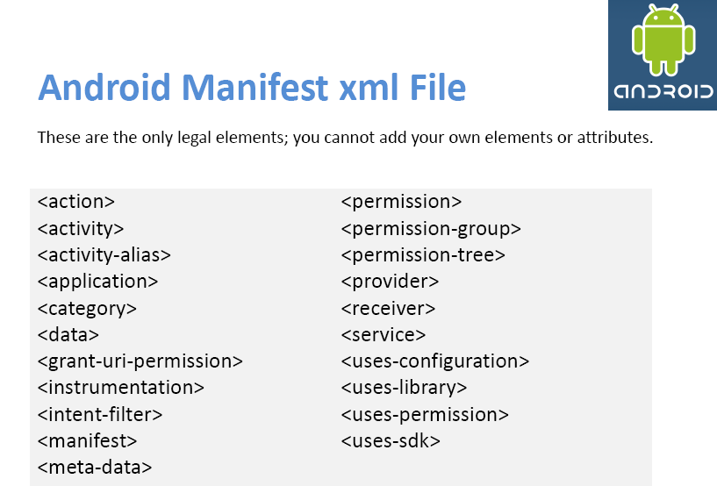

Slide 22
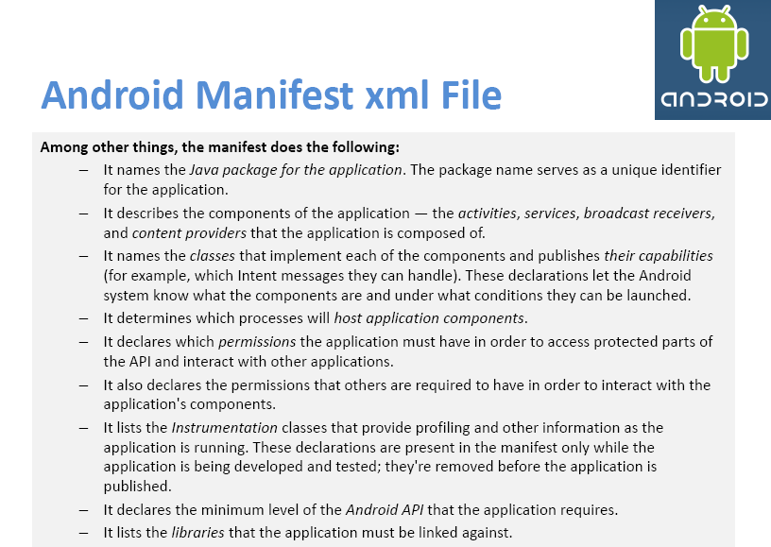

Slide 23
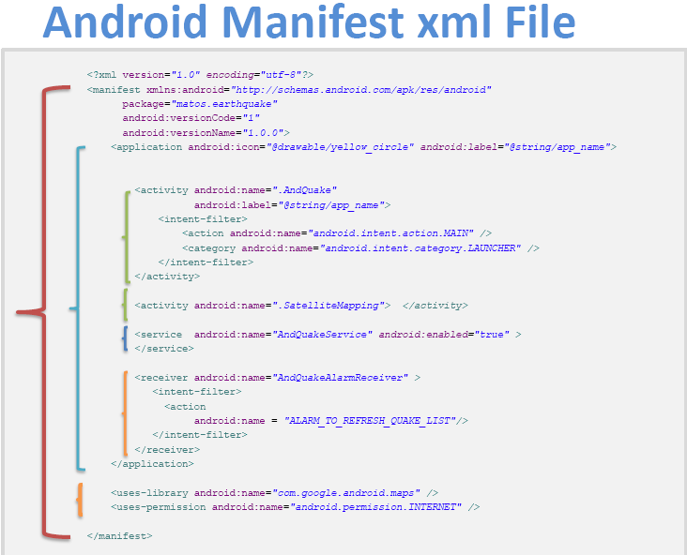

Slide 24
Android Version | Release Date | Code Name
1.1 | February 09, 2009
1.5 | April 30, 2009 | Cupcake
1.6 | September 15, 2009 | Donut
2.0 | October 26, 2009 | Eclair
2.2 | May 20, 2010 | Froyo
2.3 | December 06, 2010 | Gingerbread
3.0 | February 22, 2011 | Honeycomb
4.0.1 | October 19, 2011 | Ice Cream Sandwich
4.1 | 3rd Quarter of 2012 | Jelly Bean
 | 2013 | Key Lime Pie

Slide 25
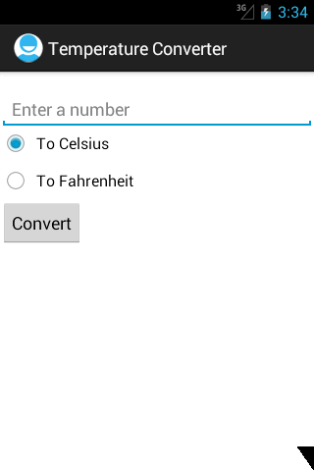
Convert Fahrenheit To Celsius
((fahrenheit - 32) * 5 / 9);
Convert Celsius To Fahrenheit
((celsius * 9) / 5) + 32;

Slide 26
public void onClick(View v) {
Float fnumber = Float.parseFloat(number.getText().toString());
Float result = null;
if(cel.isChecked())
{
result = (fnumber-32)*5/9;
}
else if(fah.isChecked())
{
result = ((fnumber*9)/5)+32;
}
number.setText(result.toString());
}

Slide 27
THANK yOU

